Slide 1
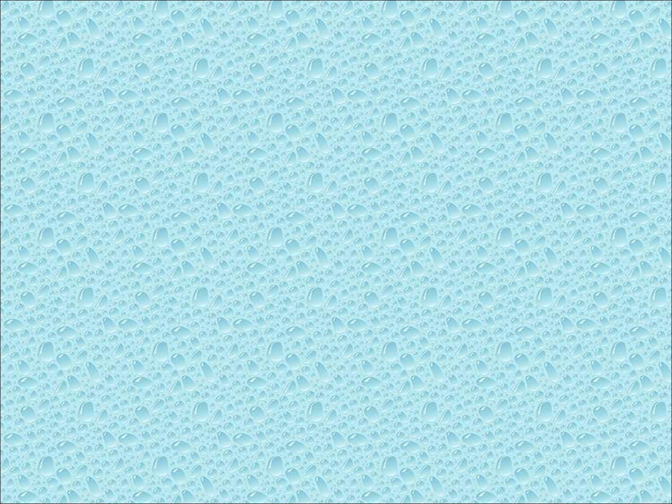


Slide 2

Introduce simple data structures for building polygonal models
  Vertex lists
  Edge lists
OpenGL vertex arrays

Slide 3

Consider a mesh
There are 8 nodes and 13 edges
  6 interior polygons
  7 interior (shared) edges
Each vertex has a location v_{i} = (x_{i} y_{i} z_{i})
e₂
v₅
v₆
e₈
e₃
e₉
e₁₃
v₈
v₄
e₁
e₁₁
e₁₀
e₇
v₇
e₄
v₁
v₂
e₁₂
e₆
v₃
e₅

Slide 4

Define each polygon by the geometric locations of its vertices
Leads to OpenGL code such as
Inefficient and unstructured
  Consider moving a vertex to a new location
  Must search for all occurrences
glBegin(GL_POLYGON);
glVertex3f(x1, x1, x1);
glVertex3f(x6, x6, x6);
glVertex3f(x7, x7, x7);
glEnd();

Slide 5

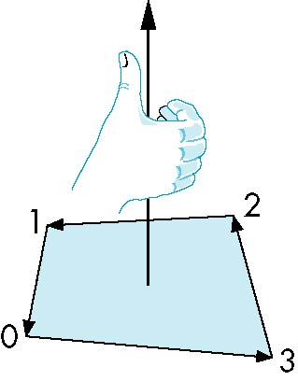
The order {v₁, v₆, v₇} and {v₆, v₇, v₁} are equivalent in that the same polygon will be rendered by OpenGL but the order {v₁, v₇, v₆} is different
The first two describe outwardly
facing polygons
Use the right-hand rule =
counter-clockwise encirclement
of outward-pointing normal
OpenGL can treat inward and
outward facing polygons differently

Slide 6

Generally it is a good idea to look for data structures that separate the geometry from the topology
  Geometry: locations of the vertices
  Topology: organization of the vertices and edges
  Example: a polygon is an ordered list of vertices with an edge connecting successive pairs of vertices and the last to the first
  Topology holds even if geometry changes

Slide 7

Put the geometry in an array
Use pointers from the vertices into this array
Introduce a polygon list
x₁ y₁ z₁
x₂ y₂ z₂
x₃ y₃ z₃
x₄ y₄ z₄
x₅ y₅ z_{5.}
x₆ y₆ z₆
x₇ y₇ z₇
x₈ y₈ z₈
v₁
v₇
v₆
P1
P2
P3
P4
P5
v₈
v₅
v₆
topology
geometry

Slide 8

Vertex lists will draw filled polygons correctly but if we draw the polygon by its edges, shared edges are drawn twice
Can store mesh by edge list

Slide 9

e₂
v₅
x₁ y₁ z₁
x₂ y₂ z₂
x₃ y₃ z₃
x₄ y₄ z₄
x₅ y₅ z_{5.}
x₆ y₆ z₆
x₇ y₇ z₇
x₈ y₈ z₈
v₆
e₃
e1
e2
e3
e4
e5
e6
e7
e8
e9
v1
v6
e₉
e₈
v₈
e₁
e₁₁
e₁₀
e₇
v₇
e₄
v₁
v₂
e₁₂
e₆
v₃
e₅
Note polygons are
not represented

Slide 10

Model a color cube for rotating cube program
Define global arrays for vertices and colors
GLfloat vertices[][3] = {{-1.0,-1.0,-1.0}
,{1.0,-1.0,-1.0},{1.0,1.0,-1.0},
{-1.0,1.0,-1.0}, {-1.0,-1.0,1.0},
{1.0,-1.0,1.0}, {1.0,1.0,1.0},
{-1.0,1.0,1.0}};
GLfloat colors[][3] = {{0.0,0.0,0.0},{1.0,0.0,0.0},
{1.0,1.0,0.0}, {0.0,1.0,0.0}, {0.0,0.0,1.0},
{1.0,0.0,1.0}, {1.0,1.0,1.0}, {0.0,1.0,1.0}};

Slide 11

Draw a quadrilateral from a list of indices into the array vertices and use color corresponding to first index
void polygon(int a, int b, int c , int d)
{
glBegin(GL_POLYGON);
glColor3fv(colors[a]);
glVertex3fv(vertices[a]);
glVertex3fv(vertices[b]);
glVertex3fv(vertices[c]);
glVertex3fv(vertices[d]);
glEnd();
}

Slide 12

void colorcube( )
{
polygon(0,3,2,1);
polygon(2,3,7,6);
polygon(0,4,7,3);
polygon(1,2,6,5);
polygon(4,5,6,7);
polygon(0,1,5,4);
}
5
6
2
1
7
4
0
3
Note that vertices are ordered so that
we obtain correct outward facing normals

Slide 13

The weakness of our approach is that we are building the model in the application and must do many function calls to draw the cube
Drawing a cube by its faces in the most straight forward way requires
  6 glBegin, 6 glEnd
  6 glColor
  24 glVertex
  More if we use texture and lighting

Slide 14

OpenGL provides a facility called vertex arrays that allows us to store array data in the implementation
Six types of arrays supported
  Vertices
  Colors
  Color indices
  Normals
  Texture coordinates
  Edge flags
We will need only colors and vertices

Slide 15

Using the same color and vertex data, first we enable
  glEnableClientState(GL_COLOR_ARRAY);
  glEnableClientState(GL_VERTEX_ARRAY);
Identify location of arrays
  glVertexPointer(3, GL_FLOAT, 0, vertices);
  glColorPointer(3, GL_FLOAT, 0, colors);
data array
3d arrays
stored as floats
data contiguous

Slide 16

Form an array of face indices
Each successive four indices describe a face of the cube
Draw through glDrawElements which replaces all glVertex and glColor calls in the display callback
GLubyte cubeIndices[24] = {0,3,2,1,2,3,7,6
0,4,7,3,1,2,6,5,4,5,6,7,0,1,5,4};

Slide 17

Method 1:
Method 2:
number of indices
what to draw
for(i=0; i<6; i++) glDrawElements(GL_POLYGON, 4,
GL_UNSIGNED_BYTE, &cubeIndices[4*i]);
format of index data
start of index data
glDrawElements(GL_QUADS, 24,
GL_UNSIGNED_BYTE, cubeIndices);
Draws cube with 1 function call!!

